Slide 1
Graph Coloring
and
Graph Partitioning
By: Sierra Norstrom

Slide 2

Overview
Explanations of Graph Coloring and Graph Partitioning
History of Graph Coloring
How many ways can you color a Graph?
Greedy Coloring
Examples of Graph Coloring and Partitioning
Applications of Graph Coloring
Questions
Sources

Slide 3
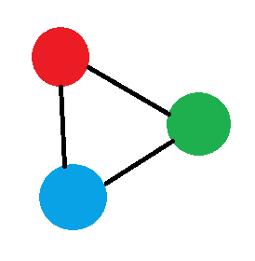

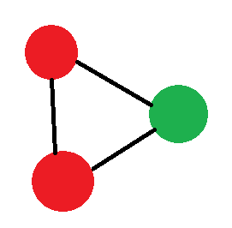

What is Graph Coloring?
Graph Coloring is a special case of graph labelling, where you assign colors to vertices in a graph
Has simple rules for it:
All adjacent colors must be different from each other
Use as few colors as you can
Basically just a way of sorting
There is also Edge Coloring
Coloring Edges from Vertices instead of the Nodes
Same rules apply
Run Time of O(2^{n}n)
Complexity of NP-Complete

Slide 4
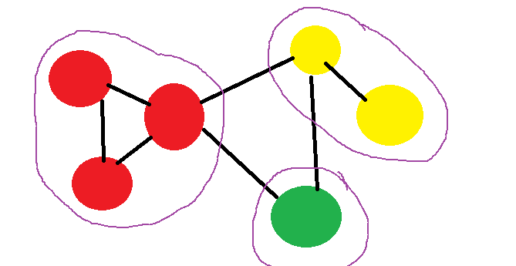
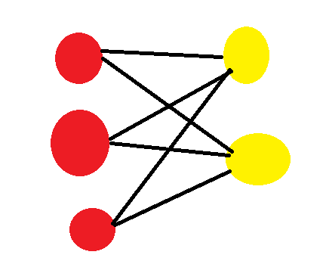
What is Graph Partitioning?
In mathematics, it’s the reduction of a graph to a smaller graph
Grouping ‘sets’ or same colors into their own clusters
Same colors probably connected
In Graph Coloring, it is the organization of a Graph Colored Set
Grouping same colors into rows

Slide 5
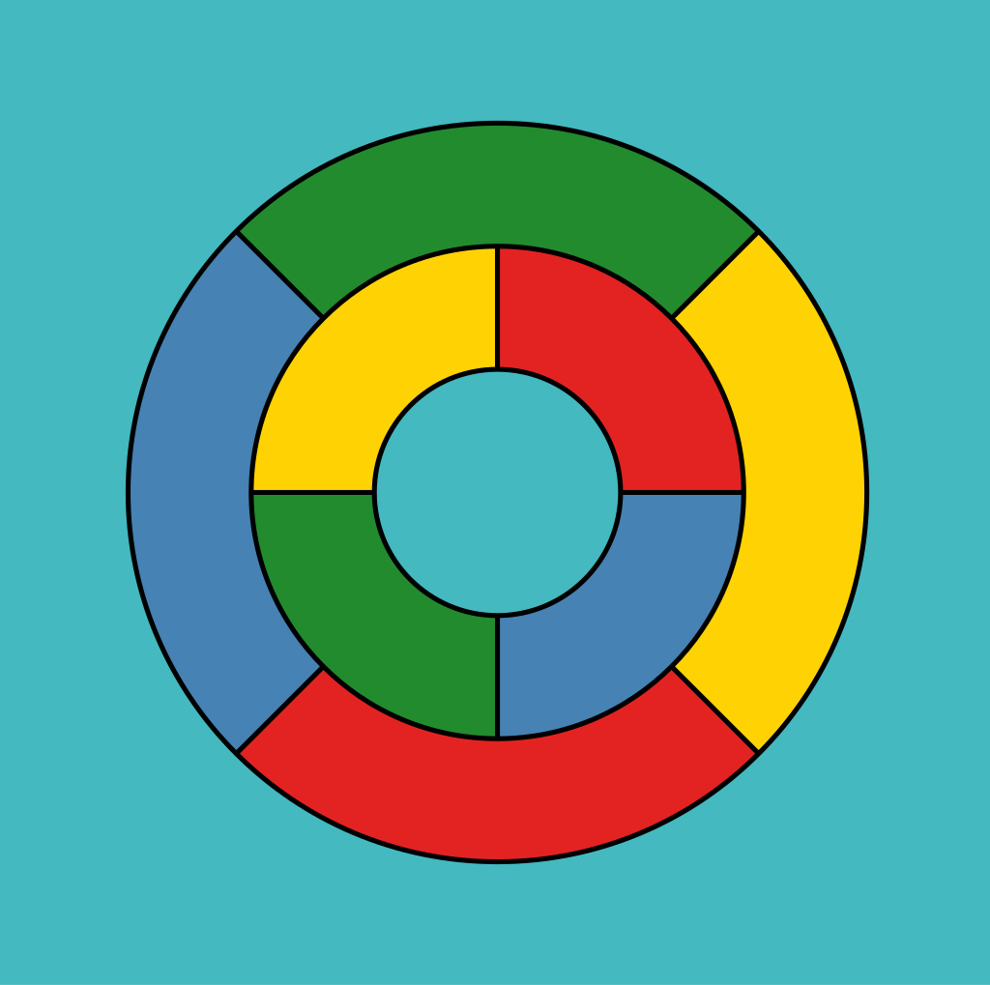
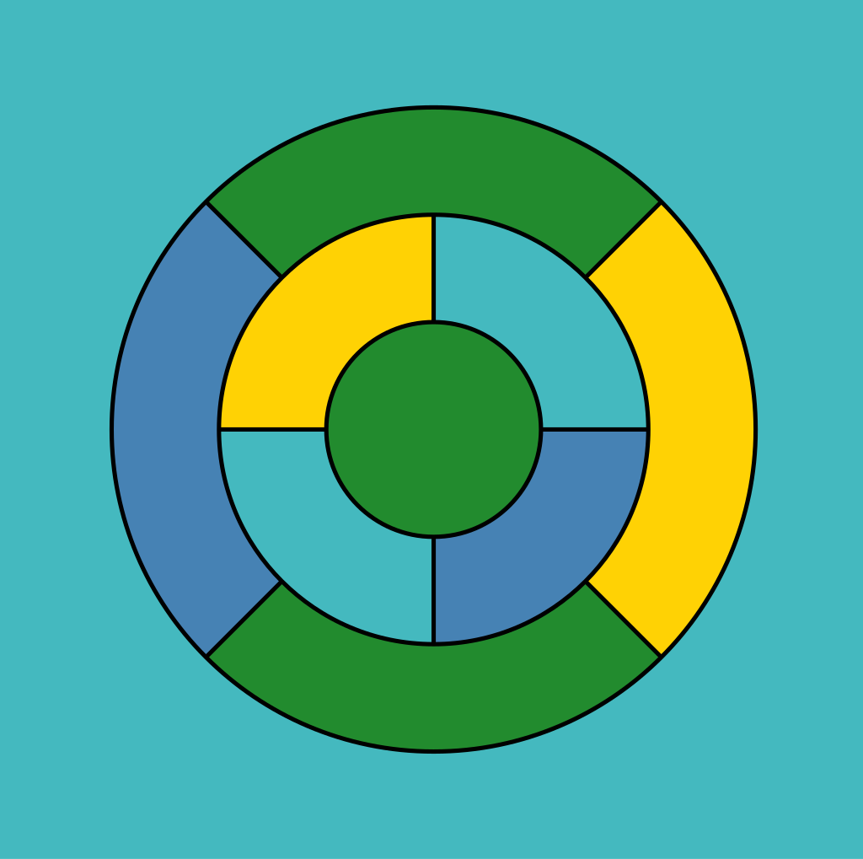
History of Graph Coloring pt. 1
As far as we know
Started with Map Coloring back in 1852
4-Color Theorem by Francis Guthrie
Changed to 5-Color Theorem in 1890 by Percy John Heawood
Back to 4-Colors in 1976, after being proven through a Computer by Kenneth Appel and Wolfgang Haken
Simplified further in 2005 by Benjamin Werner and Georges Gonthier with the Rocq Prover
5-color graph
4-color graph

Slide 6
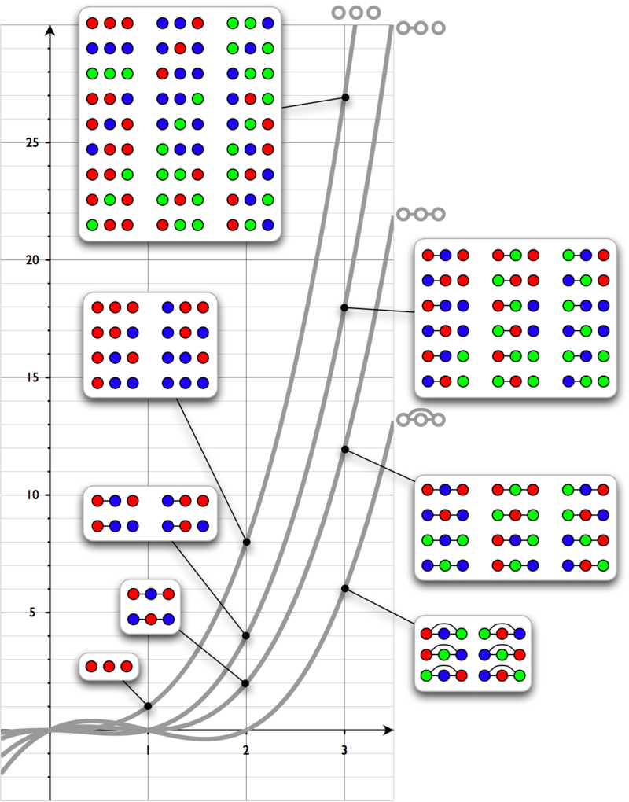
History of Graph Coloring pt 2
In 1912, George David Birkhoff introduced the Chromatic Polynomial to solve 4-Color Theorem
Part of Algebraic Graph Theory
Counts Graph Colorings as a function of the number of Colors
Finds how many different coloring patterns there can be depending on the amount of colors and the graph
Was Generalized to the Tutte Polynomial by W. T. Tutte

Slide 7
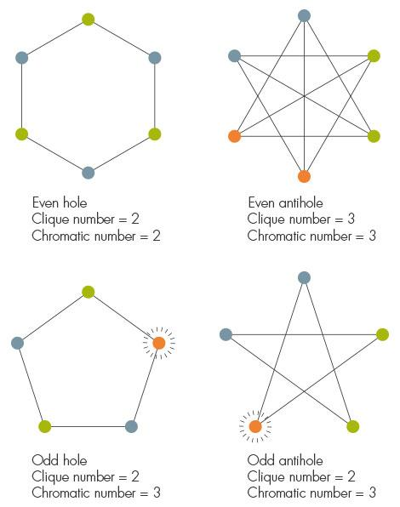
History of Graph Coloring pt. 3
In 1960, Claude Berge formulated the ‘Strong Perfect Graph Conjecture’
Was solved in 2002 by Maria Chudnovsky, George Neil Robertson, Paul D. Seymour, and Robin Thomas
A Forbidden Graph Characterization of Perfect Graphs
Neither odd holes (odd-length induced cycles of length at least 5) nor odd antiholes (complements of odd holes)

Slide 8
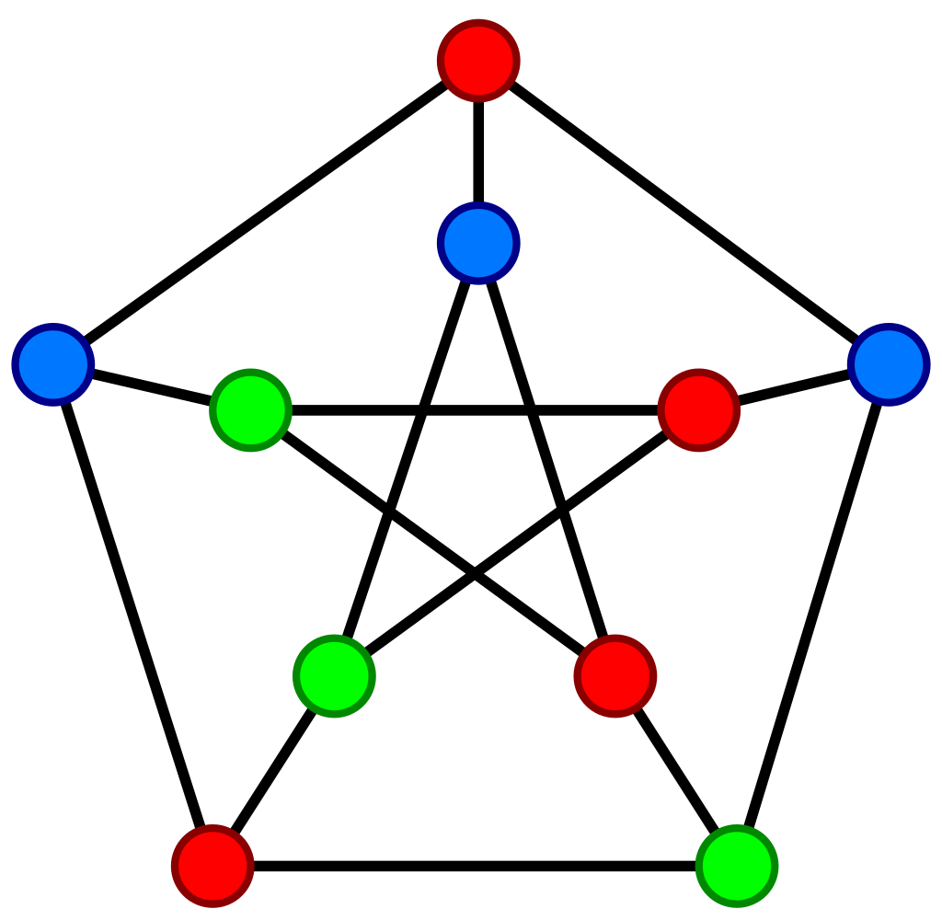
How many ways can a graph be Colored?
First, determine the type of graph, and then use the correct Chromatic Polynomial to solve
P(G, t), where P stands for polynomial, G for graph, and t is the amount of colors, there is also n, which is the amount of vertices
Line Pattern of 3: t(t - 1)^2 (t - 2)
Triangle Pattern of 3: t(t - 1)(t - 2)
Complete Graph Kn: t(t - 1)(t - 2) … (t - (n - 1))
Tree with n Vertices: t(t - 1)^(n - 1)
Cycle Cn: (t - 1)^n + (-1)^n (t - 1)
Petersen Graph: t(t - 1)(t - 2)(t^7 - 12t^6 + 67t^5 - 230t^4 + 529t^3 - 814t^2 + 775t - 352)

Slide 9
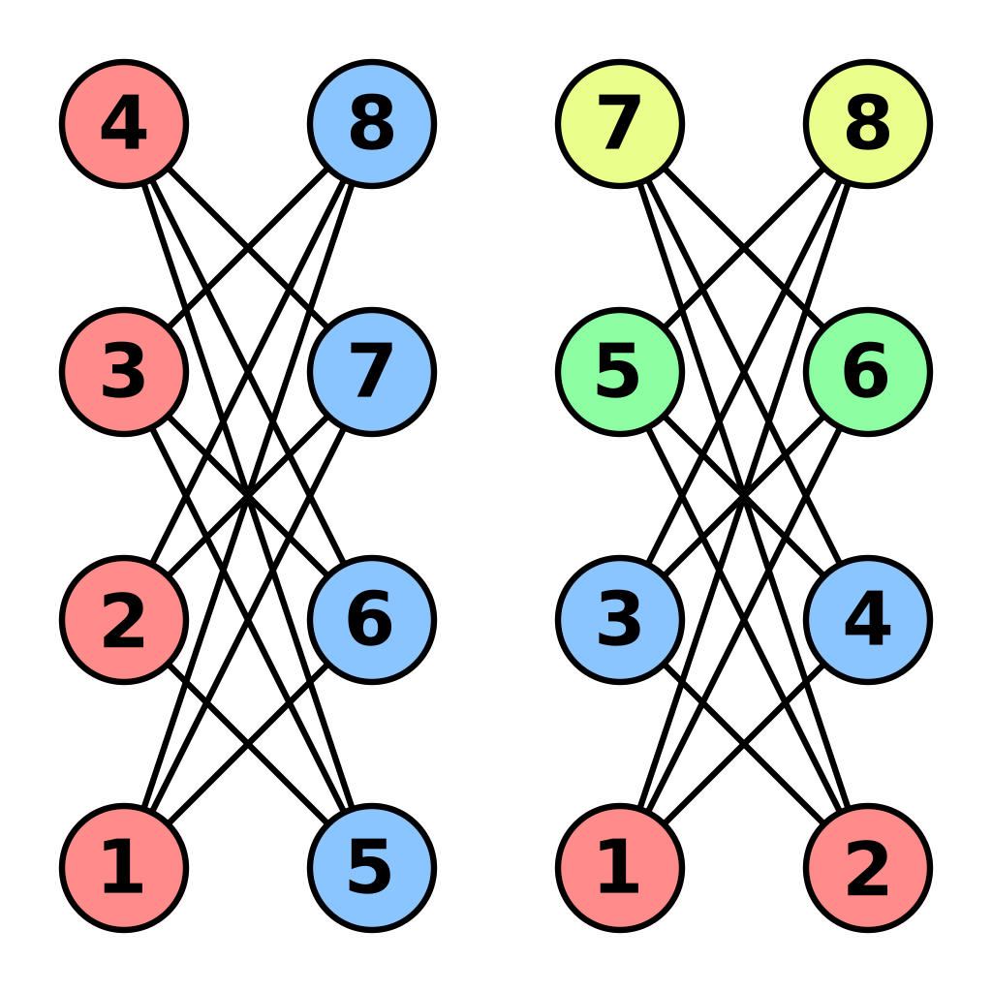
Greedy Coloring
Way of Coloring a Graph according to Graph Coloring Rules based on first available color and Vertex order
Does not always use smallest amount of colors
The coloring tends to be automatically optimal

Slide 10
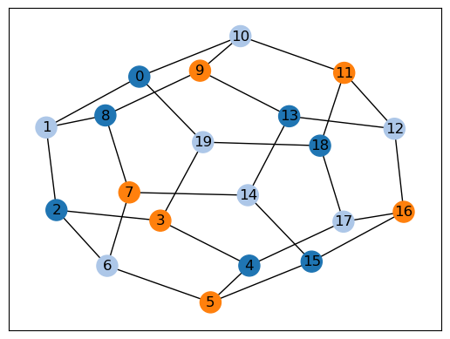
Examples of Graph Coloring
Open-Source Python Library GCol
20-Vertices
3 Colors

Slide 11
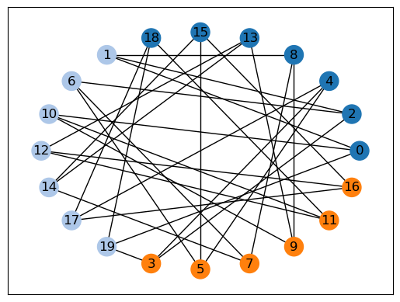
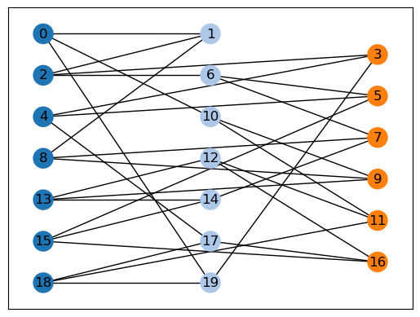
Example of Partitioning a Graph Coloring
Same 20-Vertice Shape but partitioned

Slide 12
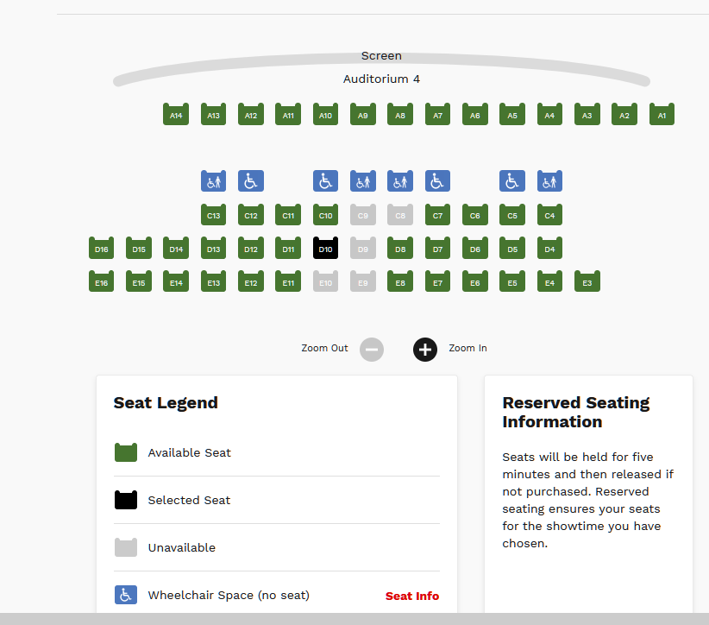
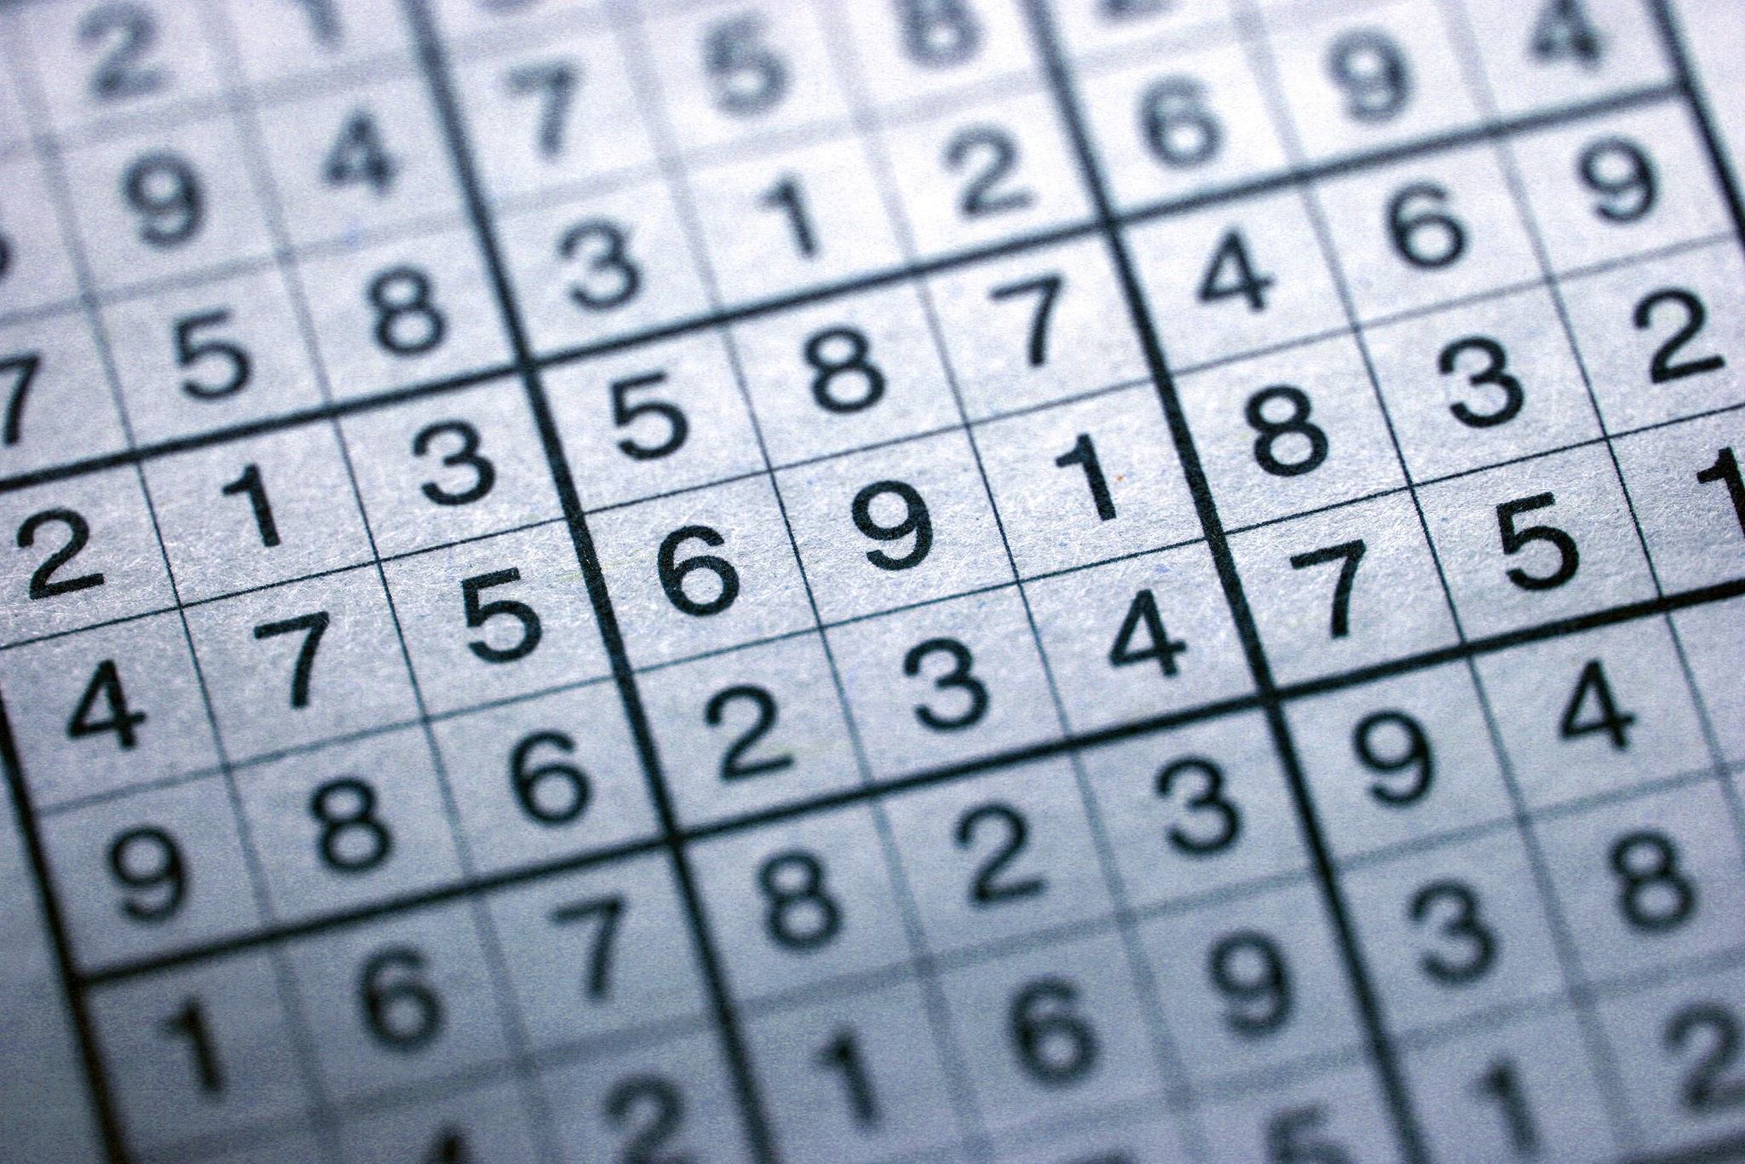
Applications of Graph Coloring
Scheduling
Can Highlight conflicts in time/resources
Timetabling
Register Allocation
Seating Plans
Sudoku
Games
Everyday Life

Slide 13
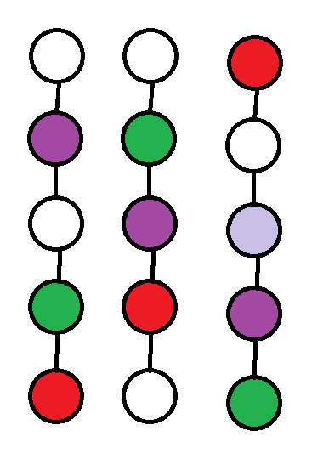
Questions :)
Can you apply Graph Coloring to a room you’re in?
Yes
No
What
Yes!!!!
If we say each person is a vertex, and the rows of seats are lines, then we can color a graph based on each seat

Slide 14
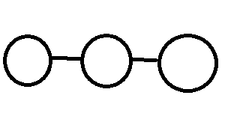
Questions :)
2. How many ways can this graph be colored with three colors?
1
3
5
12
d. 12
Using the formula from earlier (t(t - 1)^2(t - 2))
If we plug in 3 for t, we get 12

Slide 15
Sources
https://gcol.readthedocs.io/en/latest/
https://en.wikipedia.org/wiki/Graph_coloring
https://en.wikipedia.org/wiki/Graph_partition
https://en.wikipedia.org/wiki/Chromatic_polynomial
https://en.wikipedia.org/wiki/Strong_perfect_graph_theorem
https://www.quantamagazine.org/theorists-draw-closer-to-perfect-coloring-20151020/
https://en.wikipedia.org/wiki/Greedy_coloring

